Slide 1
Chapter 3
Transport Layer
Introduction
Notes:
Version History
8.1. Updates throughout, including a lot more animations. These are the ppt files used to make Chapter 2 online lectures in Sept. 2020.
8.0 (April 2020)
All slides reformatted for 16:9 aspect ratio
All slides updated to 8th edition material
Use of Calibri font, rather that Gill Sans MT
Add LOTS more animation throughout

Slide 2
What we’ll study
Transport layer role and services
Develop/design some simple transport protocol

Slide 3








Role of Transport Layer
Provide logical communication between application processes running on different hosts
Run on end hosts
  Sender: breaks application messages into segments,
  and passes to network layer
  Receiver: reassembles segments into messages, passes to application layer
application
transport
network
data link
physical
network
data link
physical
network
data link
physical
network
data link
physical
logical end-end transport
network
data link
physical
network
data link
physical
application
transport
network
data link
physical

Slide 4

















Two principal Internet transport protocols
application
transport
network
data link
physical
TCP: Transmission Control Protocol
  reliable, in-order delivery
  congestion control
  flow control
  connection setup
UDP: User Datagram Protocol
  unreliable, unordered delivery
  no-frills extension of “best-effort” IP
services not available:
  delay guarantees
  bandwidth guarantees
mobile network
national or global ISP
logical end-end transport
local or regional ISP
home network
content
provider
network
application
transport
network
data link
physical
datacenter
network
enterprise
network

Slide 5
Transport Layer Services
Application Layer
Gives services to
Transport Layer
End-to-end delivery
Addressing
De/Multiplexing
Connection Control
Reliable Delivery
Receives/relies services from
Network Layer

Slide 6
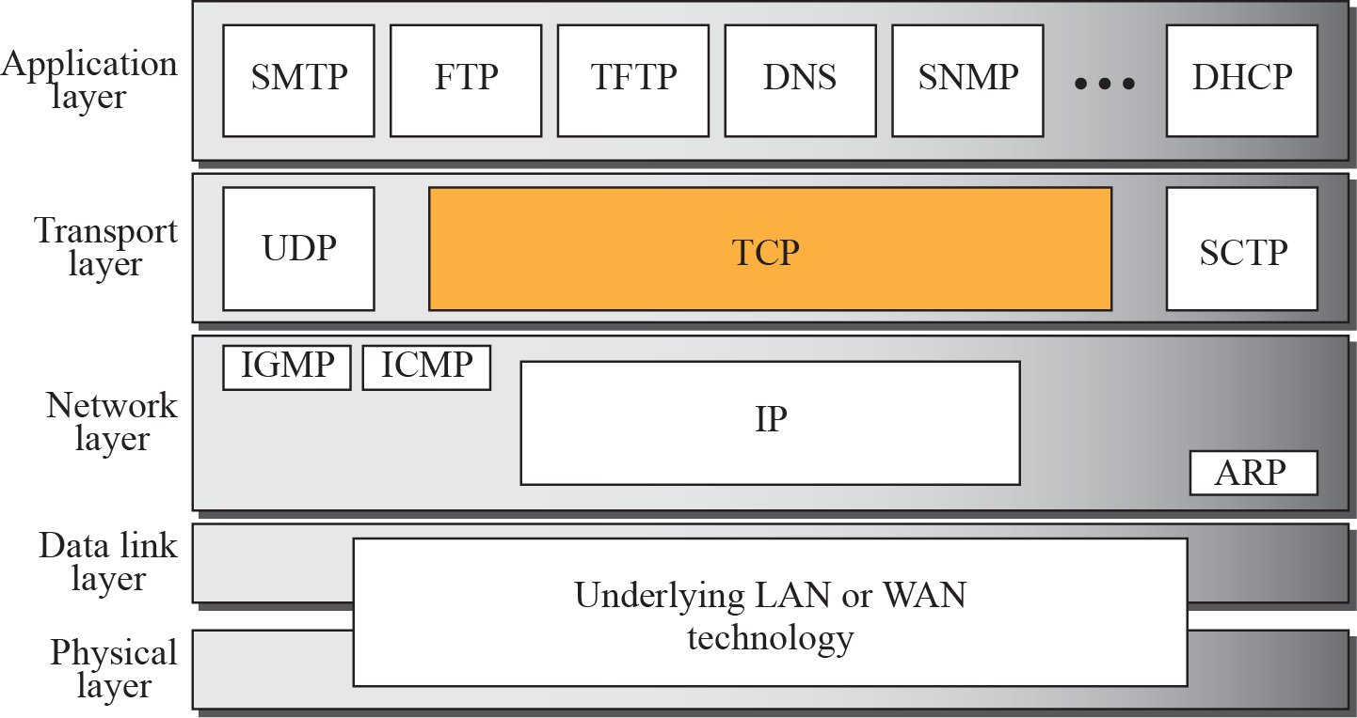
TCP/IP Protocol Suite
6
Notes:
6

Slide 7
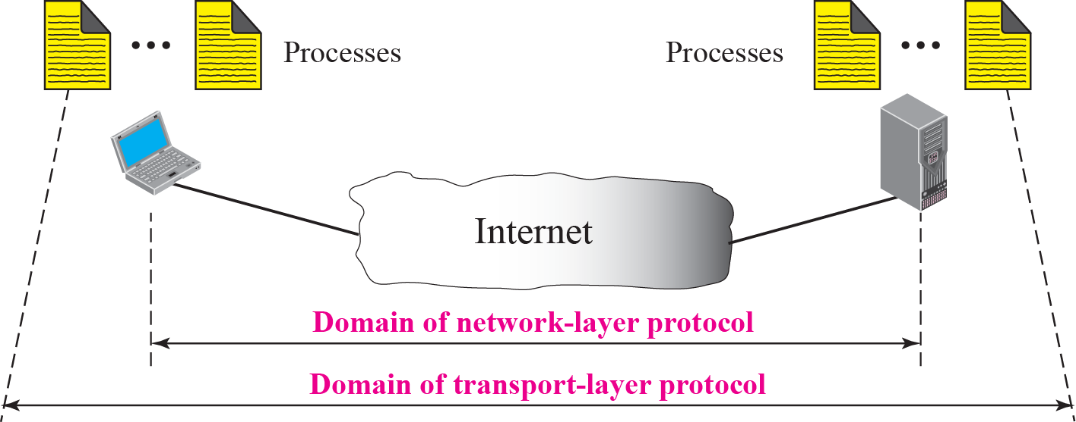
Figure 13.1 Network layer versus transport layer

Slide 8
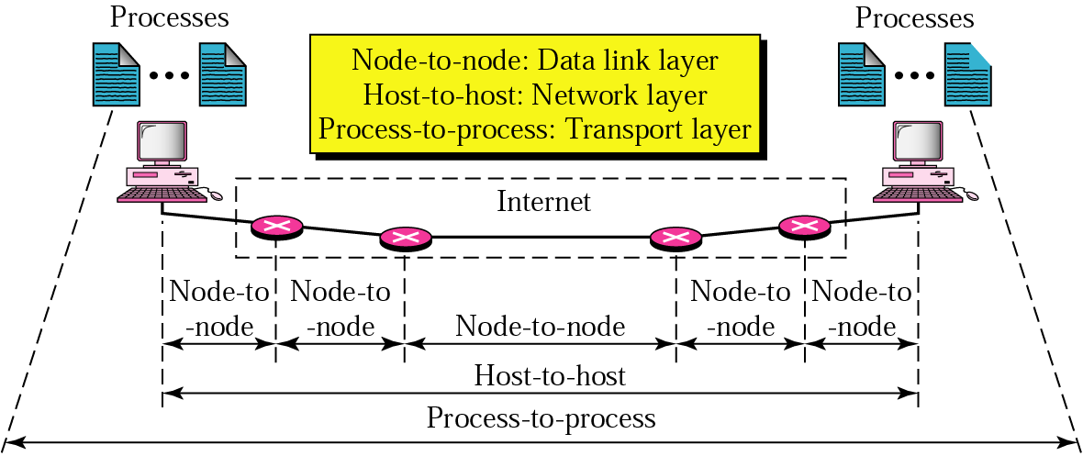
Process-to-process delivery
Several processes (application programs) can run on both the source and the destination host

Slide 9
Analogy
Two houses, each with a dozen of kids, are located in Eindhoven and Amsterdam.
All kids in different houses are relatives (cousins)
Each kid weekly writes a letter to every other kid in another house
  144 letters/week in total (huge cost)
    Dutch kids would probably use e-mail (low cost)
In each household there is one kid (Jantje & Pietje, respectively) responsible for mail collection and mail distribution
  each week they give all the letters to a postal-service mail carrier who makes daily visits to the house.
Application message = letters in the envelope
Processes = cousins
Hosts (end systems) = houses
Transport-layer protocol = Jantje & Pietje
Network-layer protocol = postal service (including mail carriers)

Slide 10
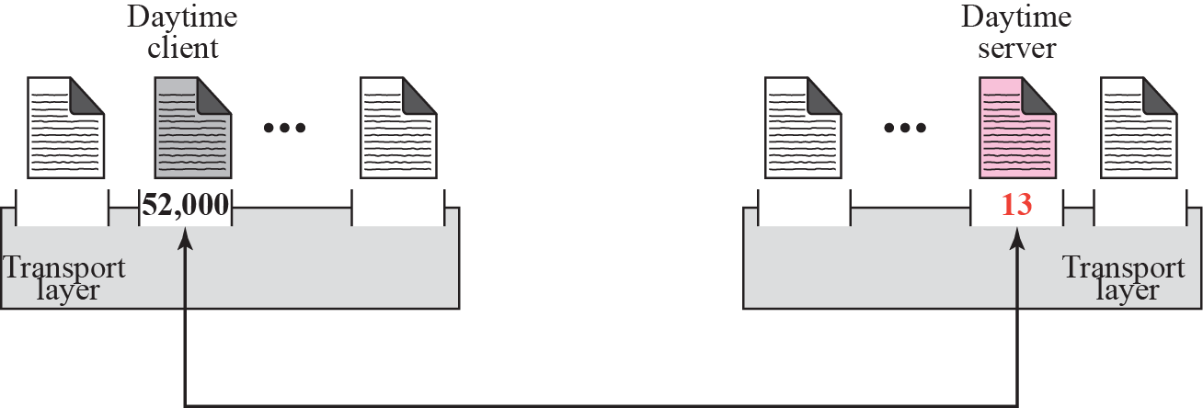
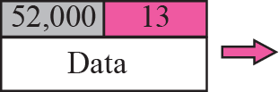
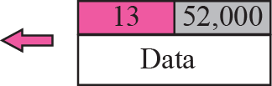
Figure 13.2 Port numbers

Slide 11
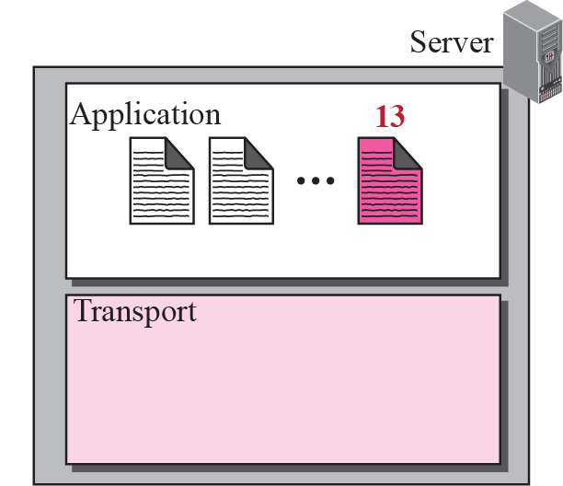
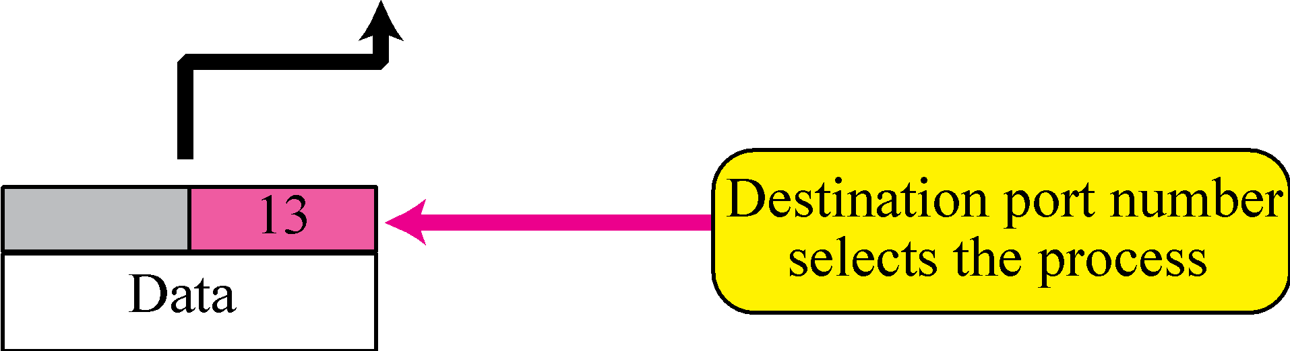
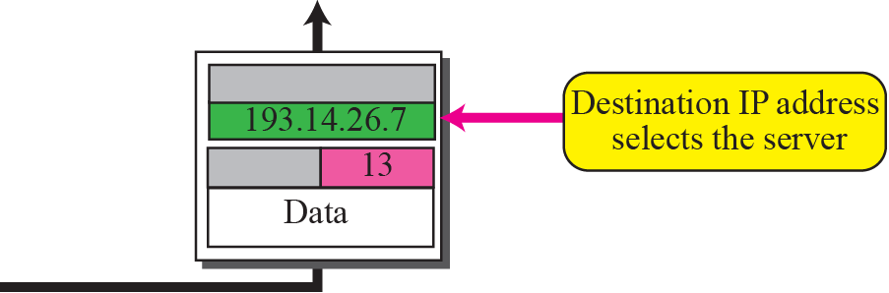
Figure 13.3 IP addresses versus port numbers

Slide 12
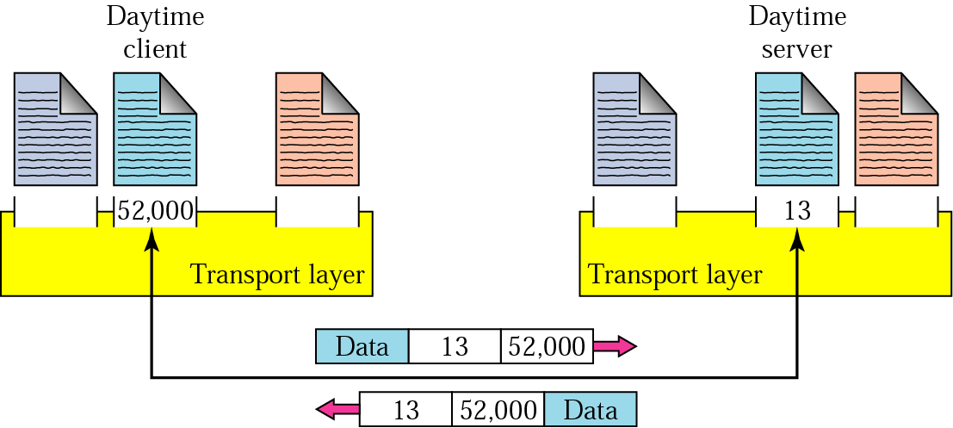
Addressing
Data link - MAC address
Network – IP address
Transport – port number
  needed to choose among multiple processes running on the destination host
  The Internet model: 16 bit integer 0 – 65 535
    Client mostly chooses ephemeral port number
    Server mostly uses well-known (permanent) port numbers
ephemeral port number
well-known port number

Slide 13
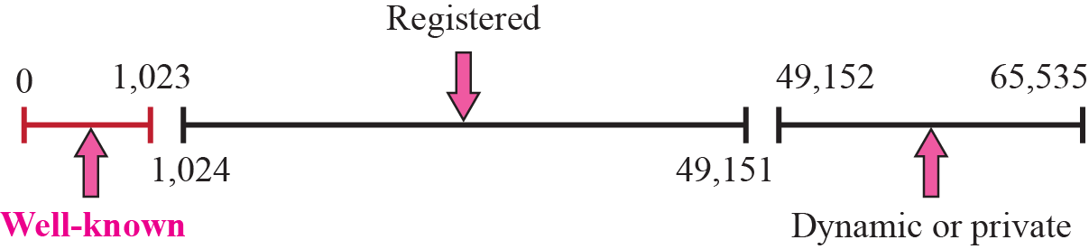
Figure 13.4 ICANN ranges

Slide 14
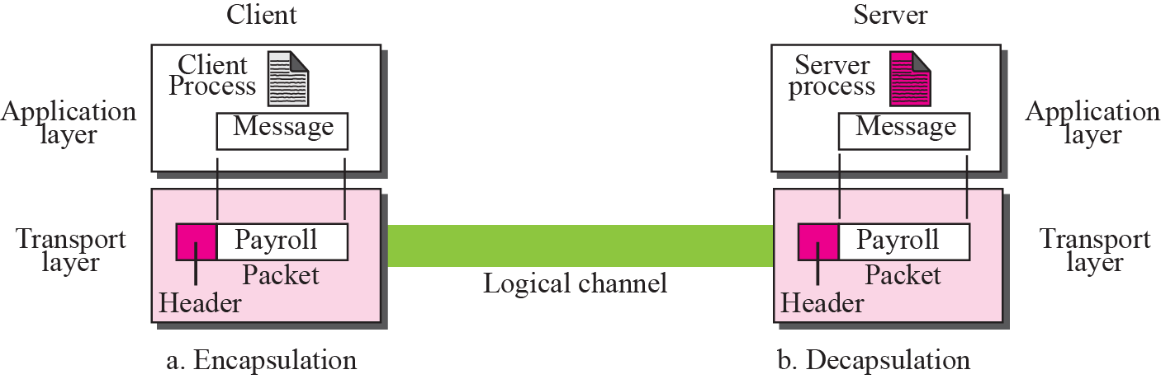
Figure 13.6 Encapsulation and decapsulation

Slide 15
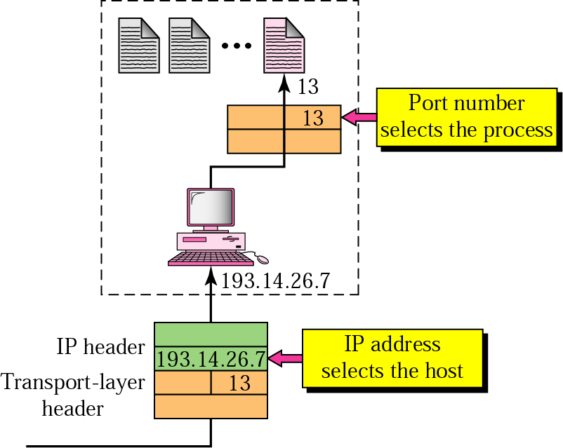
IP addressing versus port addressing
destination IP defines the host
after the host has been selected:
the port number defines one of the processes on this host

Slide 16
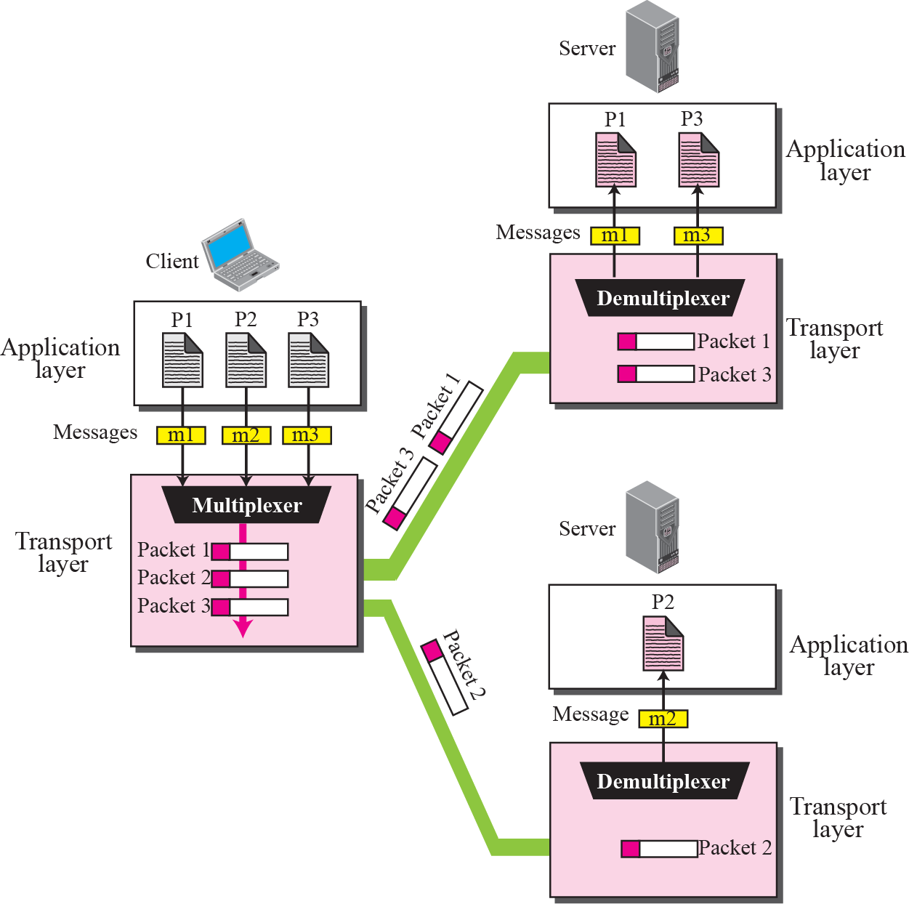
Transport layer MUX & DeMUX
Transport layer de/multiplexes several processes on the transport layer protocol

Slide 17
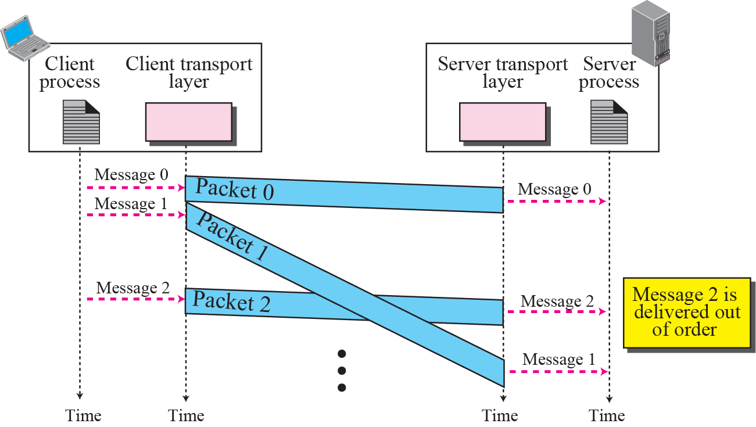
Connection control
Connectionless services
  no connection establishment
  packets are not numbered, may be delayed, lost or arrive out of order
  UDP

Slide 18
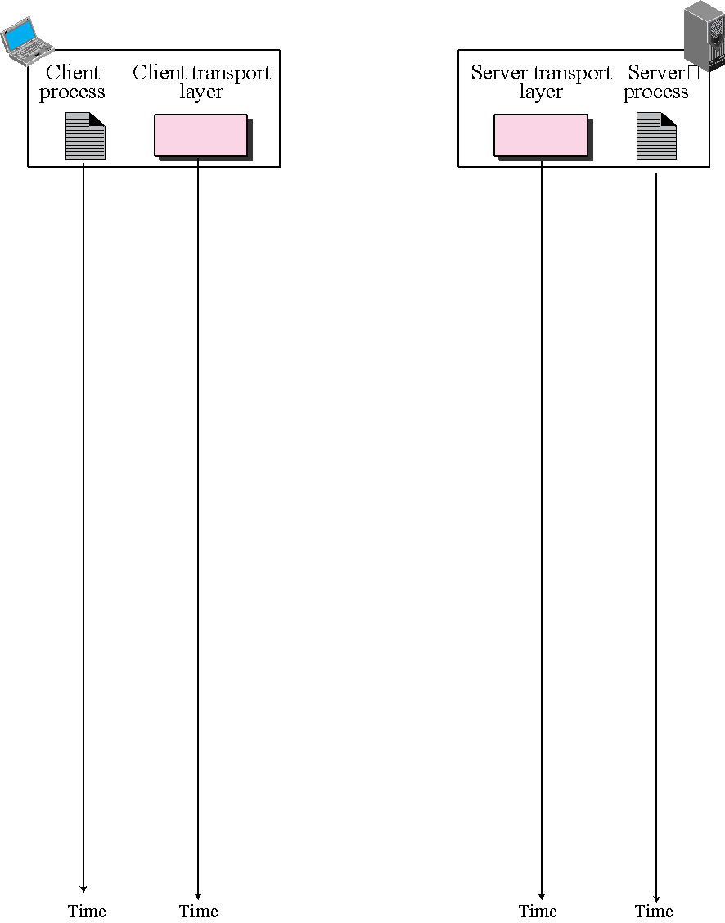
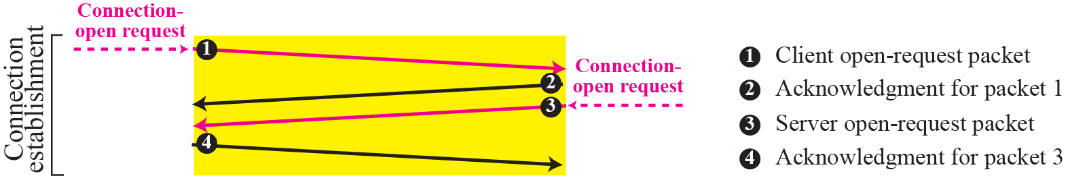
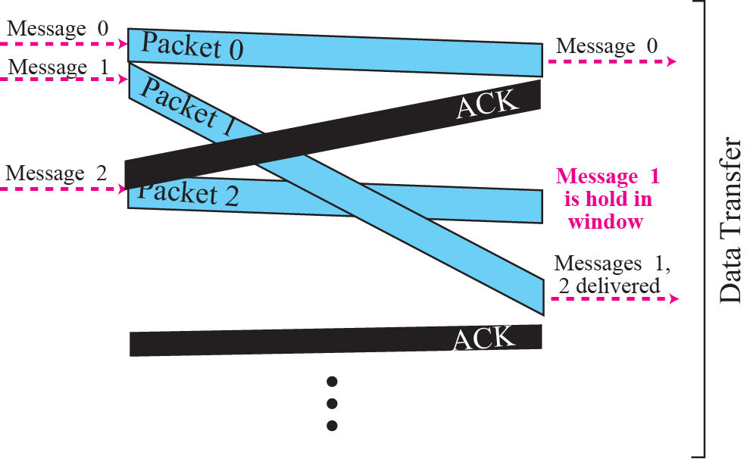
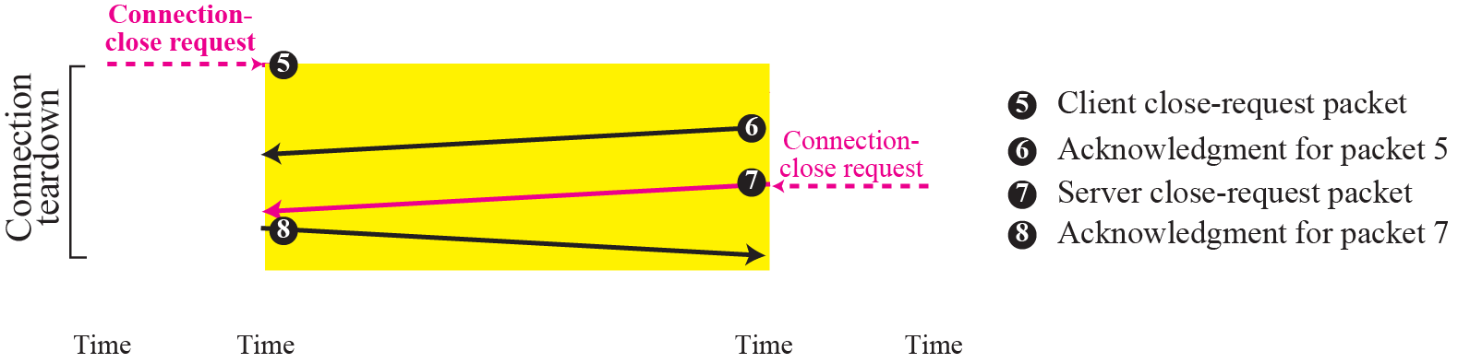
Figure 13.14 Connection-oriented service

Slide 19
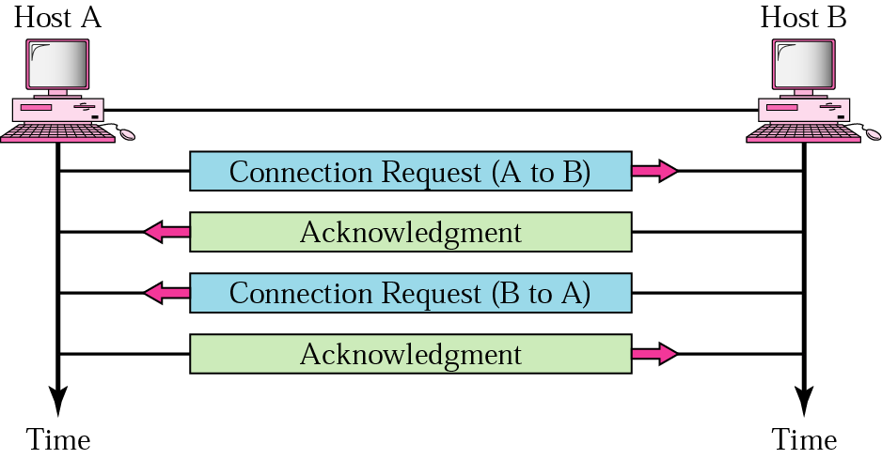
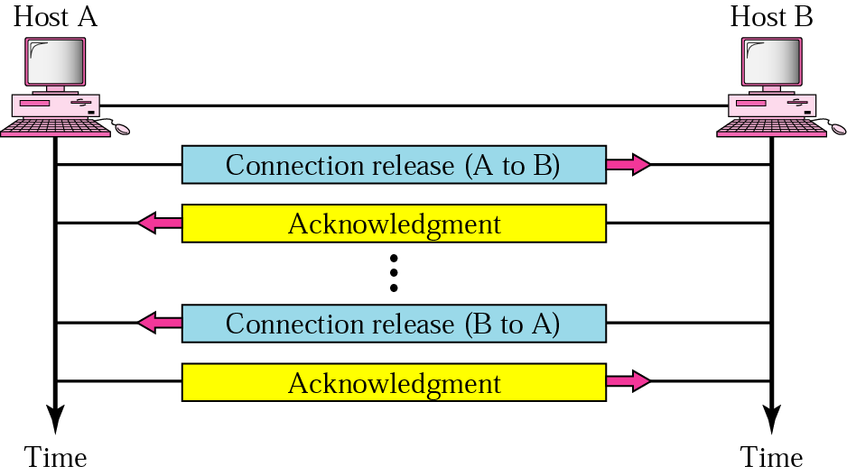
Connection control
Connection-oriented services
  connection established prior to data transmission
  TCP
What is the difference with respect to the Network layer services?
  transport code runs only on the user’s machine and not in the routers (usually operated by the carriers)
  Network layer can offer inadequate service (frequent packet loss, routers crash from time to time); user does not have control over the Network layer
Establishment: three way handshake
Connection termination

Slide 20
Reliable delivery
Reliable services
  error control
    Detect and discard corrupted packets.
    Keep track of lost and discarded packets and resend them.
    Recognize duplicate packets and discard them.
  flow control
    Sender doesn’t overwhelm the receiver
  congestion control
    Manage network load within its capacity
  TCP
Unreliable service
  UDP

Slide 21
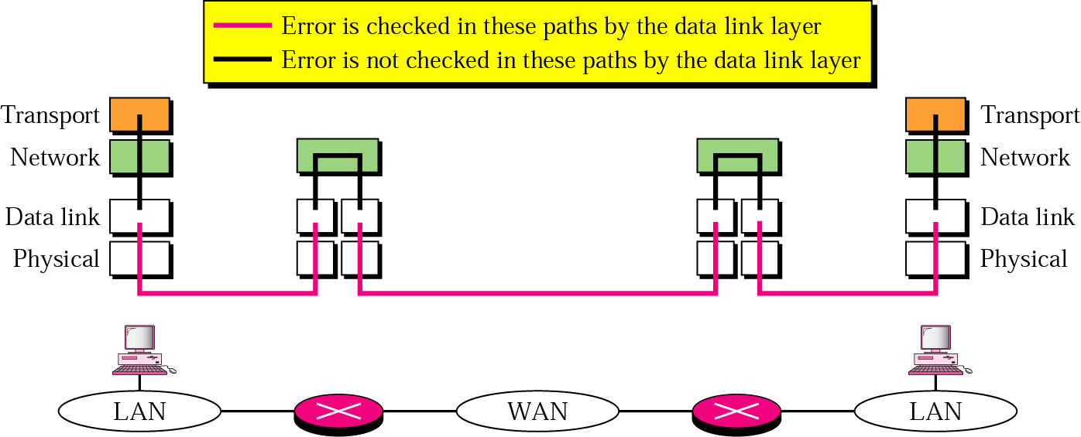
Reliable delivery
Question: Do we need reliable transport service if the Data link transport is reliable?
Yes

Slide 22
Thank You!

